Slide 1
CERTIFICATION MANAGEMENT
BY: SIMRAN GUPTA

Slide 2
Topics Discussed
- About the Application
- Class Diagram
- Sequence Diagram-
- Flow and Working of the Application
- Screenshots
-Conclusion

Slide 3

About the Application
Certification Management App is a platform to track and manage salesforce certification vouchers issued to all practice members.
This application is build on custom objects – Employee, Certification, Certification Request, Voucher.
Type of Users:
App Admin – CRUD on all objects
App User – CRUD Employee, CRUD Certification Request, Read Certification and Vouchers

Slide 4
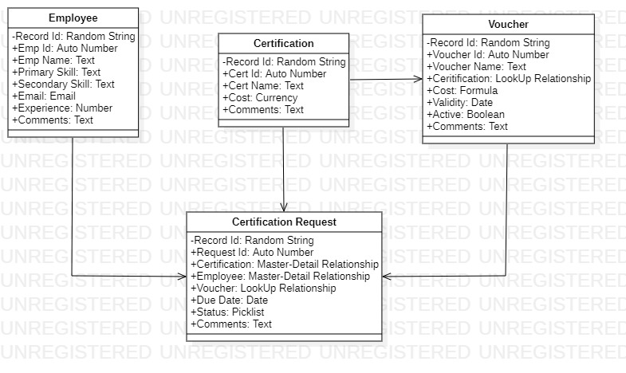
Class Diagram

Slide 5
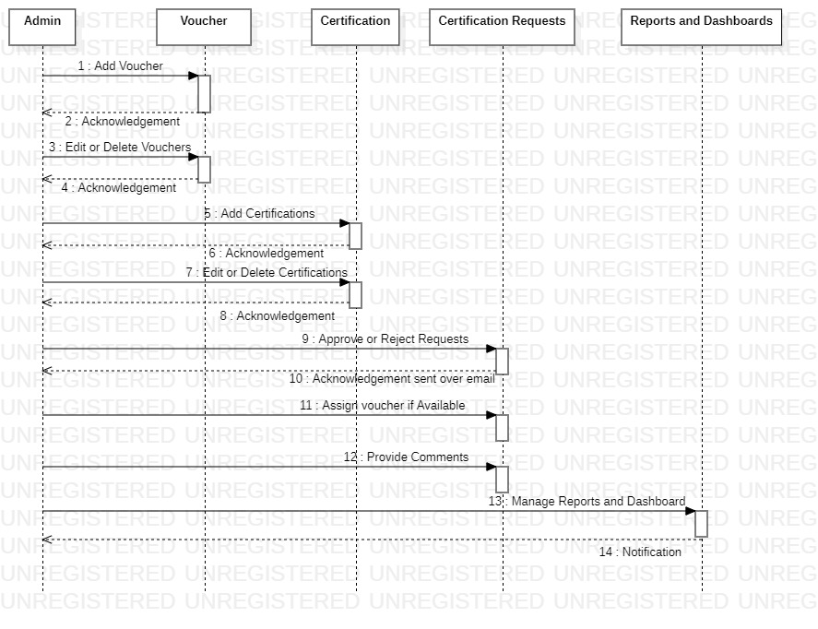
Sequence Diagram (Admin)

Slide 6
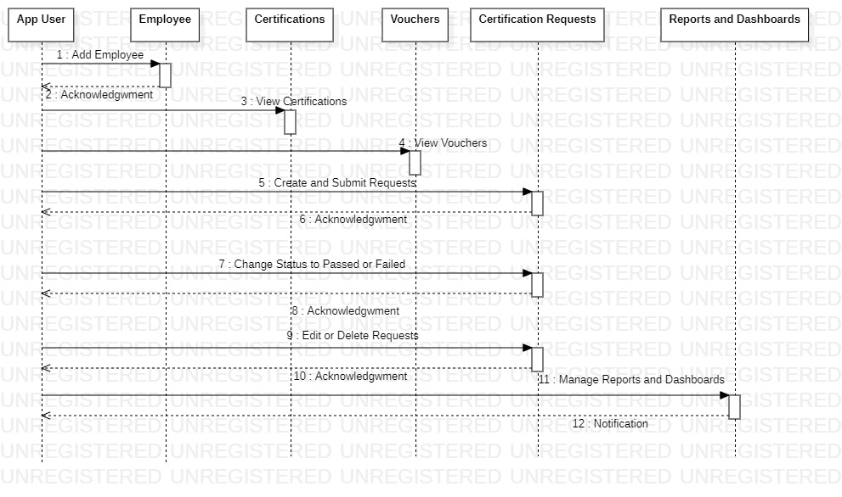
Sequence Diagram (App User)

Slide 7
Flow & Working
The App Admin creates a Certification for the Employees to be performed.
Now the App User, creates that Employee in the Application and raises the Certification Request for the Employee taking in the Certification he wants to apply for.
Now an Employee who has to perform the Certification, mails the AppUser regarding the Certification he wants to apply for.
In this process is a voucher was available, the app user would have pre- assumingly applied for the same to the Request.

Slide 8
Cont..
Now the App Admin performs reviews over the records of the Certification Request, to check the Approval items in the records which are send to him by default.
Now, if the App Admin, Approved the Request, then the Employee can write the exam.
Else, if Status is et to Rejected, then the Employee cannot appear for the Certification exam.
Once, the Employee has been approved to write the Exam, if he has no voucher applied at that moment, and there is a voucher available in the Vouchers, then it is automatically applied, in that case.

Slide 9
Cont..
Now after the Employee has appeared for the Examination, he passes on the details to the App User about his results.
Now the App User updates the results accordingly in the Application. So, this Is the whole process and this repeats over and over again.

Slide 10
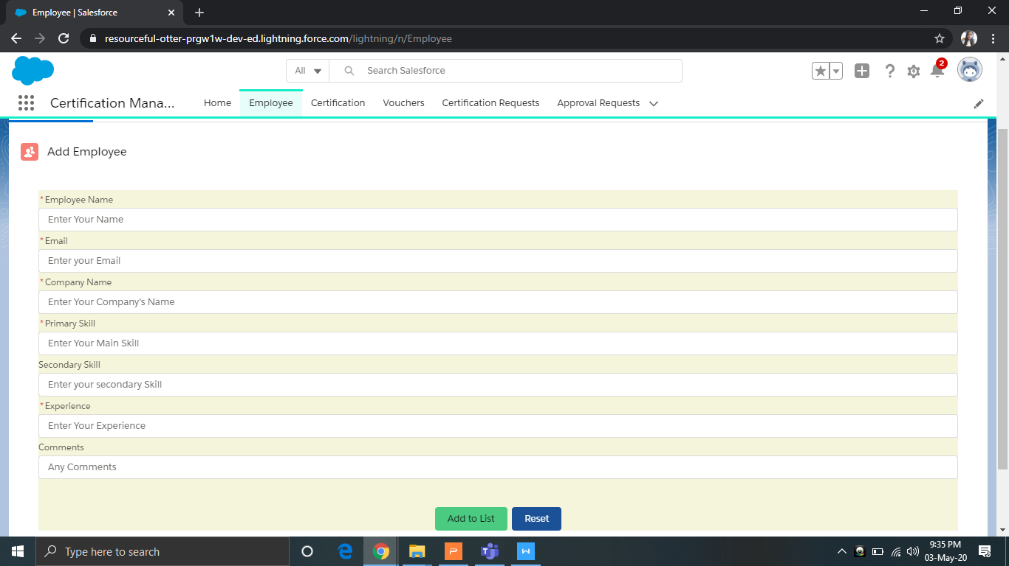
Employee
- Employee object with add employee section
- The Employee in CMA refers to the person(s) who are applying for a Certification.
- This section is managed by App User.

Slide 11
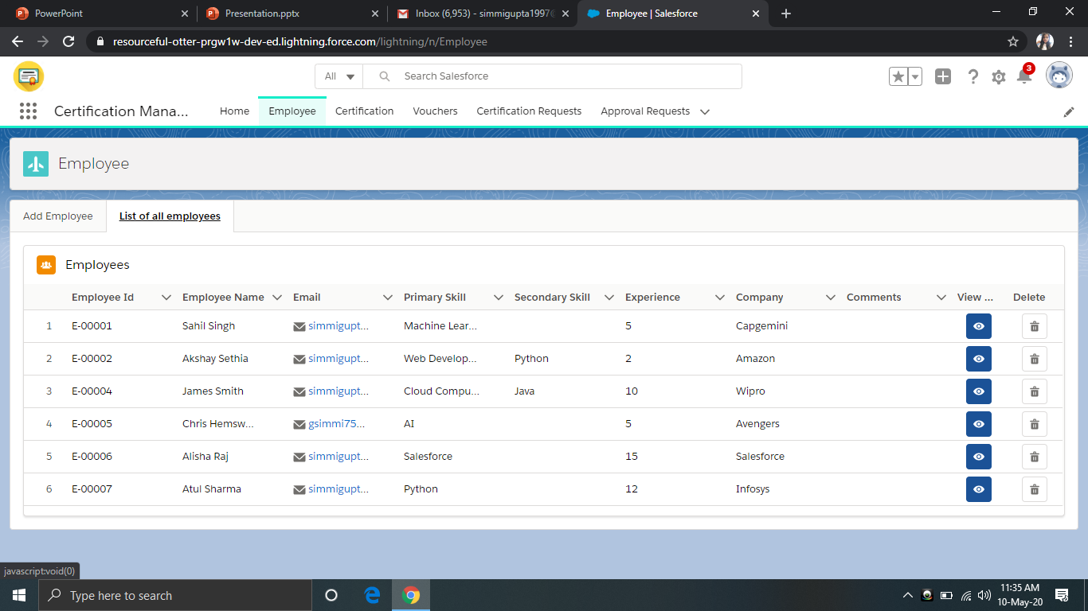
Employee
- Employee object with list of employee section.
- From here records can be viewed, edited or deleted

Slide 12
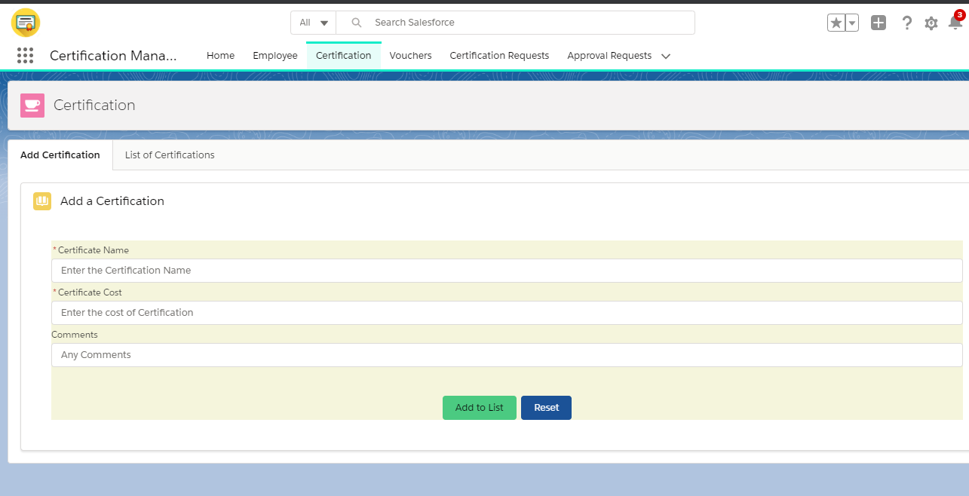
Certification
-Certification object with add certification section.
- The Certification refers to the certificates that each employee or a set of employees can peruse.
- This section can only be handled by the App Admin.

Slide 13
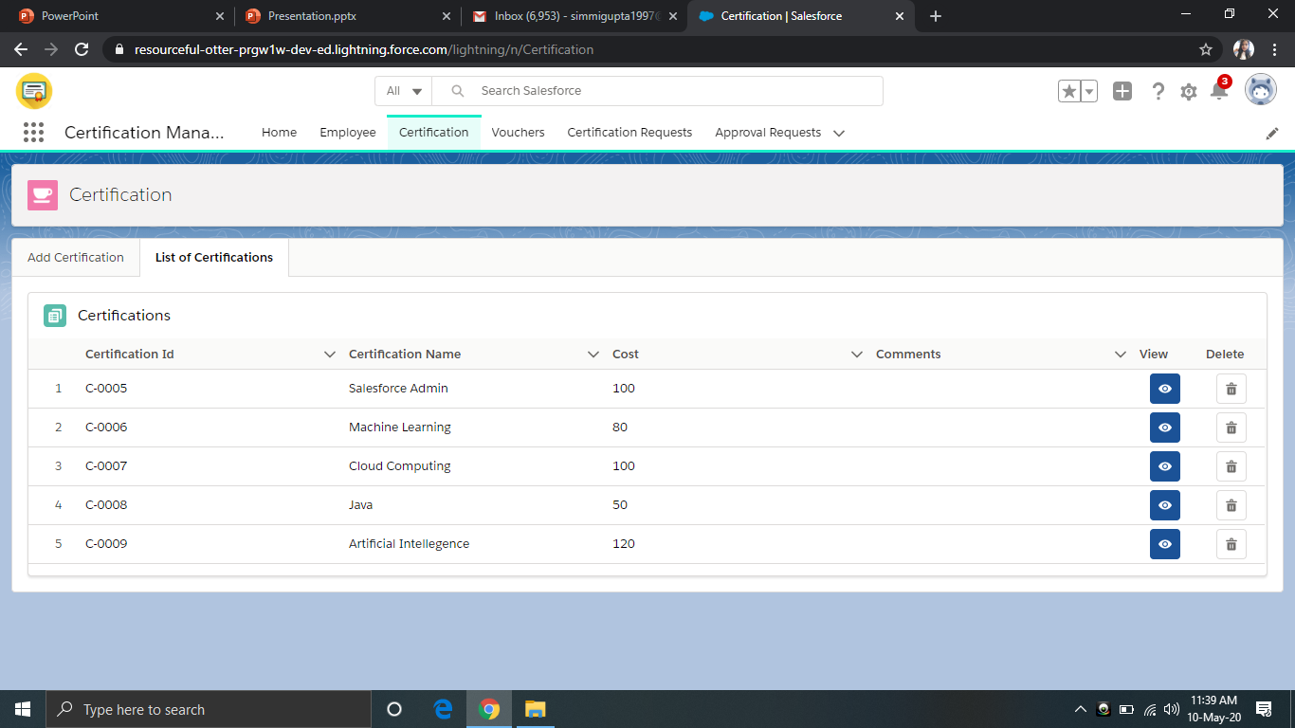
Certification
- Certification object with list of certification section.
- From here records can be viewed, edited or deleted

Slide 14
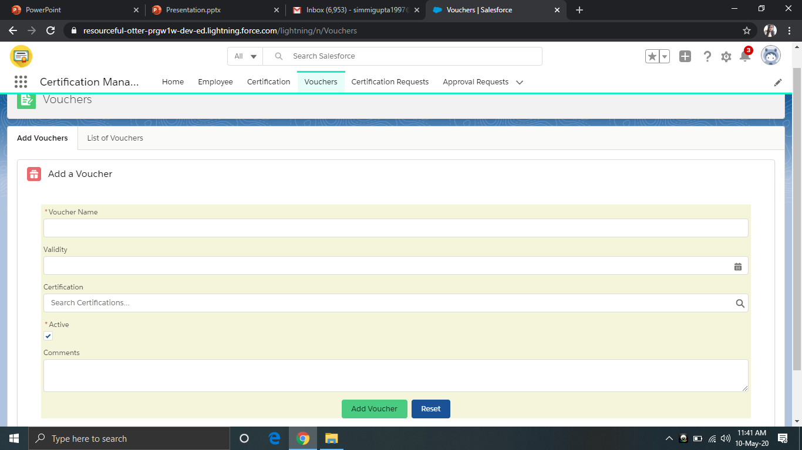
Voucher
-Voucher object with add Voucher section.
- These vouchers can be applied to certifications while raising certification request to reduce the cost of the certification.
- This section can only be handled by the App Admin.

Slide 15
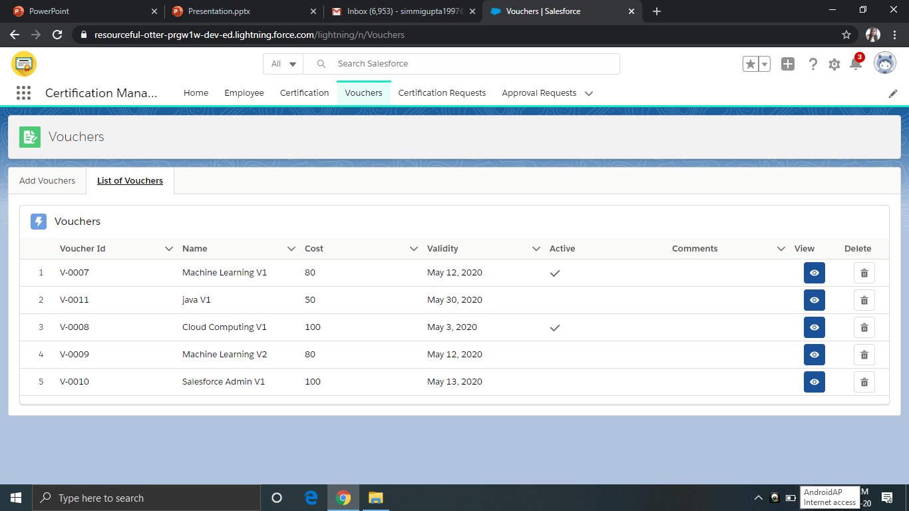
Voucher
- Voucher object with list of voucher section.
- From here records can be viewed, edited or deleted

Slide 16
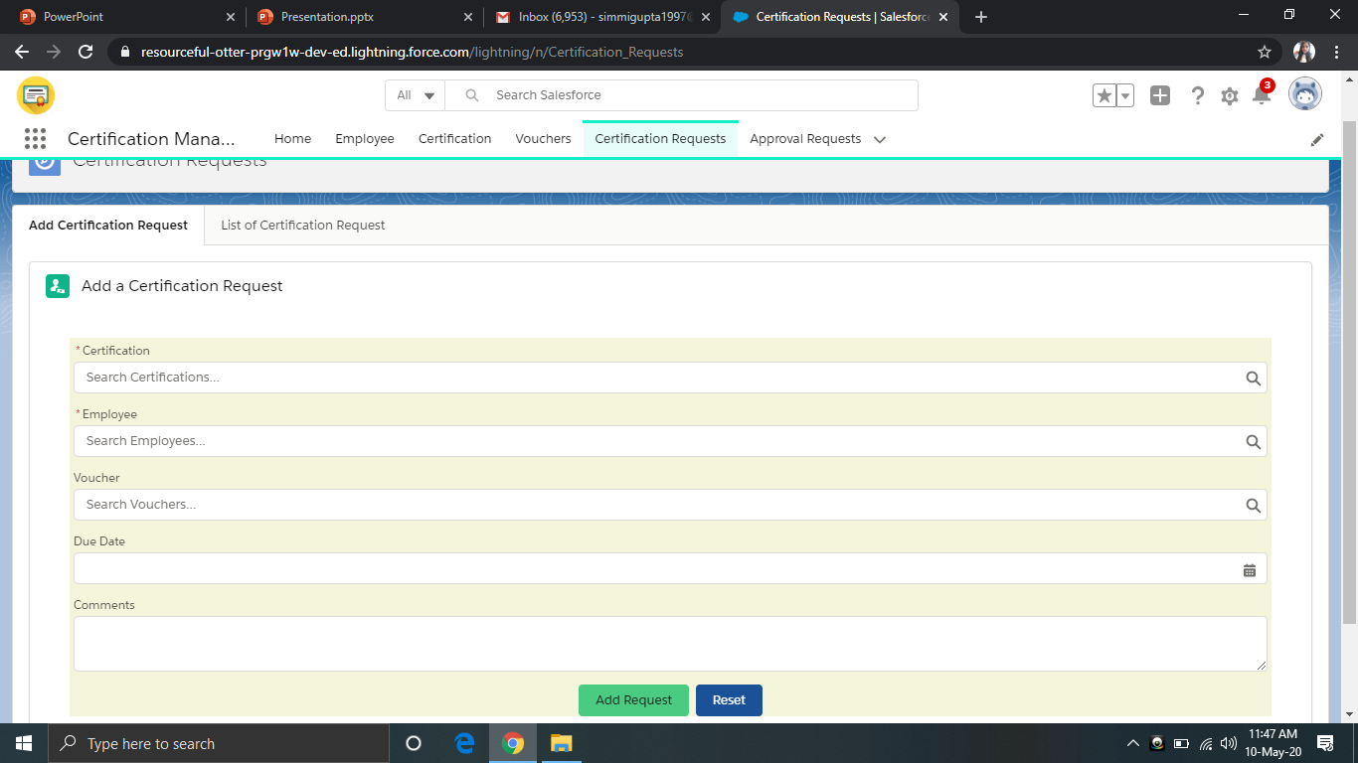
Certification Request
-Certification request object with add section.
- Employees can apply for any certification in this section.
- The certification request is managed by App User.

Slide 17
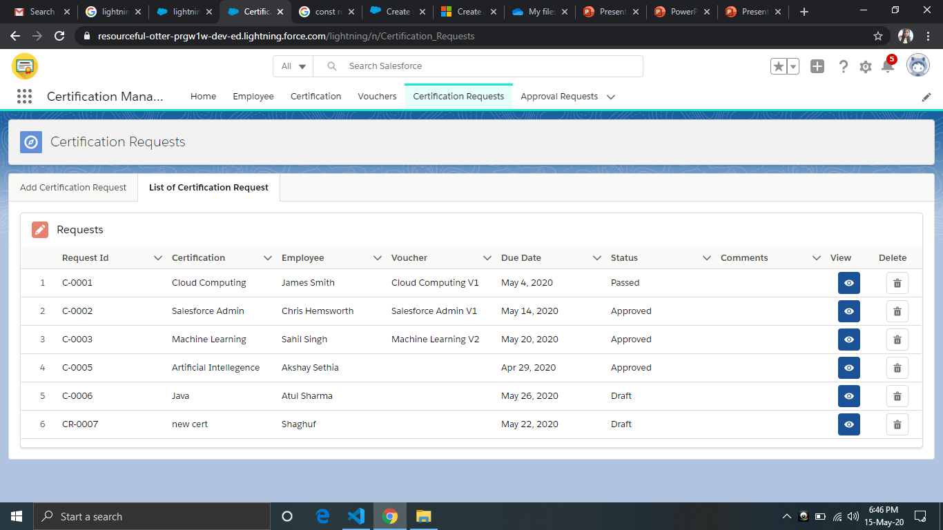
Certification Requests
- Certification Request object with list of certification request section.
- From here records can be viewed, edited or deleted

Slide 18
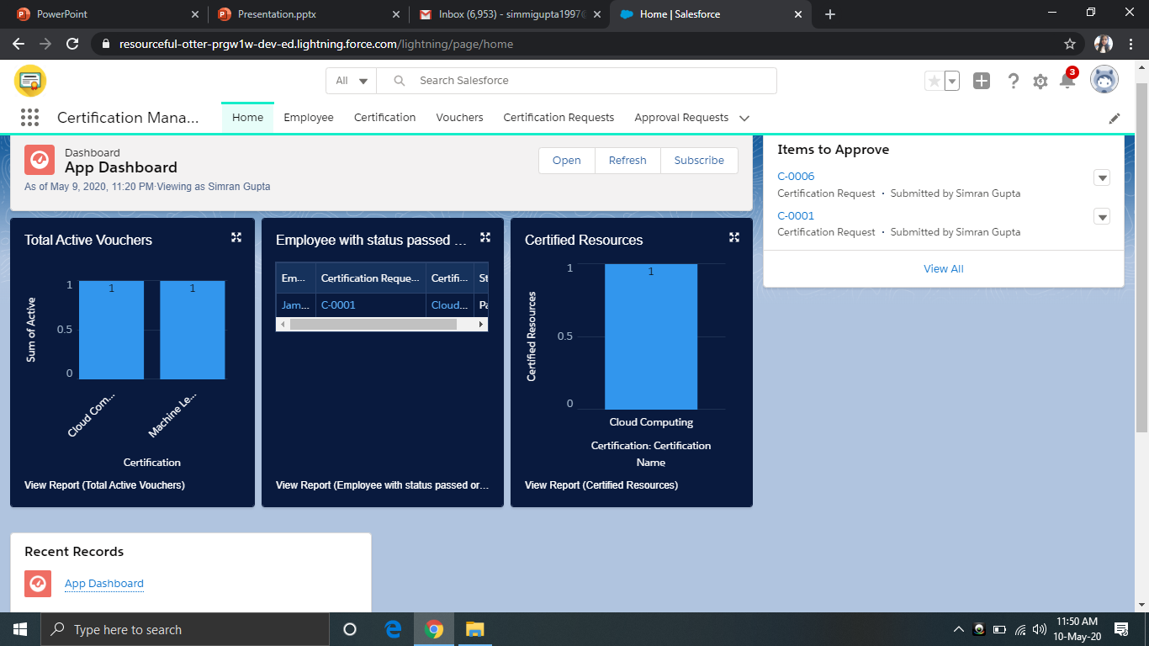
Home
- The home tab displays the App Dashboard, Items to Approve and the Recent Records.
- The Reports in dashboards are: Active vouchers, Employee with status passed or failed, Certified Resources

Slide 19


